Slide 1
2026 Weekly Portfolio Status
Pet Tech Delivery
Cindy Trudeau & Delivery Leads
Oct 12, 2026

Slide 2
Red Projects

Slide 3
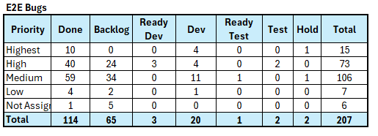
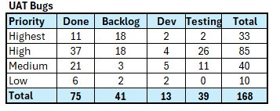
Payroll Billing Employer Portal
Seamless Self-Service Administration for Payroll Employer Groups
Delivery Leader: Ali Dadgar
OpEx Business Lead: Victor Nas
Status Date: | 10/09/2026
Overall | Scope | Schedule | Financials
2026 Revised Budget | YTD Actuals | Remaining 2026 Forecast | Total Actuals +Fcst | Original Budget
$4,111,000 | $2,526,060 | $1,162,654 | $3,688,714 | $6,200,000
Target Delivery: | Dark Launch: Oct 21 Go live: Nov 11
Overall status remains Red . The team is making solid progress in UAT, Finance, IAM, and core role-based testing. The immediate focus is converting the Highest/High validation queue into confirmed closures while maintaining momentum toward the October 21 dark launch and November 11 go-live.
Since October 1, the team has made measurable progress across testing and readiness:
IAM is green for the October 15 release. Testing and signoffs are complete, with no remaining release blockers identified. Go/No Go is scheduled for 10/9.
Finance: Improved from 41 passed / 3 failed / 18 pending to 50 passed / 0 failed / 10 pending. Finance remains an execution risk against the October 9 testing completion date. There are currently 10 high defects: 4 in backlog, 3 ready for testing , 1 in development and 2 in testing.
UAT execution increased from 168 of 551 scenarios completed (30%) to 250 of 539 (46%), with 289 scenarios remaining. 68 defects closed since last week.
Financial
  Sept month-end: YTD spend is $2.5M, down $67K month over month. Year-end spend is forecast at $3.7M, $0.4M below approved budget due to delays in filing additional Phase 2 resources. The $0.4M underspend will be released back to the Portfolio.
Milestone | Status | Due Date | Notes
Bundle 2 (Communication and Servicing)) | C | 5/6
Bundle 3 (VBO admin) | C | 5/27
Bundle 4 (Billing) | C | 8/18
Finance Schedule | C | 7/17
Dark Launch | C | 8/12
Finance Development | C | 9/2
Bundle 5 & 6 DDIT | C | 9/18
E2E Testing |  | 10/02 10/16
IAM Dark Launch |  | 10/15 | IAM GO/No GO 10/9
UAT Validation |  | 10/09 10/16 | Dates were adjusted to allow additional testing time
Portal dark launch |  | 10/21
Finance Prod Deployment |  | 10/23 | Red due to open defect and risk of testing completion by 10/9
Go Live |  | 11/11
Warranty | NS | 12/9
Onboarding, stability and user experience | NS | 4/30
“Should Have” Features | NS | 5/31/27 6/30/27 | Dates were adjusted to allow additional time for MVP
Critical Risks/Issues | Status | Target Date | Resolution / Mitigation
EP remains Red because UAT is 2 weeks behind plan, remaining PDX development/testing and UAT dates are not confirmed, and IAM, Finance, and QE dependencies could further delay testing and threaten the October 9 target, October 21 dark launch, and October 23 production date |  | 9/30 10/30 | Execute one integrated recovery plan with firm development-completion and UAT start/finish dates; resume IAM testing, prioritize critical Finance Cycle 1 scenarios, secure/replace QE capacity, and track daily progress, defects, retesting, and release readiness against the October 8, October 9, October 21, and October 23 milestones.
Status Key | C | Completed |  | On-Schedule |  | Major Issues |  | Some Issues | NS | Not Started

Slide 4
GIN / Batch Stabilization
Project Manager : Dinesh
OpEx Business Lead: Gary Wilson
Status Date: | 10/09/2026
Overall | Scope | Schedule | Financials
2026 Budget | YTD Actuals | Remaining 2026 Forecast | Total Budget
$595,000 | $485,212 | $134,110 | $670,000
Target Delivery: | 12/09/2026
Portal Stability and GIN Batch Hardening work – Completed the identified scope by 09/30/26
Received the approval for budget overage of $170K
ECIF Data Integrity effort -
Overall Status: RED–
ECIF Risk:
The ECIF team has confirmed that the Requirements phase for the MQ-to-Kafka integration for MPN and MASN can be completed within 2026.
ECIF will fulfill all onboarding requirements and provide consultation and testing support as needed, subject to resource availability and established priorities.
Due to resource constraints, the enterprise change freeze, and planned team vacations, the Data Extract and ECN Collapse components are now targeted for completion in 2027.
The ECIF effort is currently on hold pending approval of the revised estimate
ECIF re-estimated the effort and provided a revised cost estimate of $82,460, representing an increase of approximately $50K compared to the previous estimate.
Due to the scope shift into 2027, the MiM/E2E testing teams has incurred additional effort requirements, resulting in a need for $50K in incremental funding.
Path to Green
Review and approve revised ECIF estimate representing an increase of $50K asap to avoid the delays in gathering requirements from ECIF team
Confirm 2026 scope is limited to MQ-to-Kafka Requirements for MPN and MASN
Secure funding and resource commitments for 2027 scope
MQ-to-Kafka Requirements and DDIT efforts for MPN and MASN completed in 2026
Integration readiness achieved for testing and demonstrations
Resource and testing support aligned
Data Extract and ECN Collapse roadmap approved for 2027
The MiM team, with support from Ronda, established the timeline below considering ECIF resource availability and anticipated year-end holiday staffing constraints.
GIN / REN / ECIF data integrity – Original Release Plan
Convert CEM to Java Golden Path – MiM - 11/11/26 release
Migrate MQ to Kafka event streams for Agreement notifications - no new functionality MiM/ECIF - Feb 2027(02/10) release
  DDIT to be completed in 2026
Migrate MQ to Kafka event streams for Party notifications – no new functionality –
MiM/ECIF – Feb 2027 (02/10) release
  DDIT to be completed in 2026
Add Party notification event stream – consume ECN changes & registration email (January) – MiM/ECIF – Mar 2027 (03/18) release
Modify GIN Resource APIs to enable ECN update (January) (dependent on V2 to V5) –
SS – Dark Launch for Dec (12/09/26) release – SS team is exploring the possibility of dark launch for Dec 2026
Milestone | Status | Due Date | Notes
ECIF Data Integrity – Convert CEM to Java Golden Path – Analysis & DDIT |  | 10/14/26 11/11/26 | MiM team confirmed that this effort will be delivered for 11/11 DDIT is in progress
Migrate MQ to Kafka event streams for Agreement notifications - no new functionality |  | 12/09/26 02/10/27 | DDIT is planned to be completed in 2026 QA/E2E will be carry forward to 2027 Prod Release – 02/10
Migrate MQ to Kafka event streams for Party notifications – no new functionality |  | 12/09/26 02/10/27 | DDIT is planned to be completed in 2026 QA/E2E will be carry forward to 2027 Prod Release – 02/10
Add Party notification event stream – consume ECN changes & registration email |  | 12/09/26 03/18/27 | DDIT to start in Jan 2027 Prod Release – 03/18
Modify GIN Resource APIs to enable ECN update | NS | 12/09/26 | SS team is reviewing the requirements if the dark launch of the changes can be completed along with V2-V5 upgrade in Dec QA/E2E will depend and done along with above ECN changes & Registration email
Critical Risks/Issues | Status | Target Date | Resolution / Mitigation
Project remains yellow on the budget overage | C | 09/25/2026 | Budget Overage is approved.
ECIF Dependency delays and Dec 2026 target – Kafka topic mapping, onboarding activities, and development cannot proceed until ECIF analysis is completed. | C | 10/09/26 | Complete re-estimation and roadmap planning immediately. Implement a phased delivery strategy to maximize 2026 outcomes while sequencing remaining work into 2027 if necessary. Accelerate ECIF requirements analysis and onboarding sessions.
The additional funding of approx. $100K (The revised ECIF estimate of $82,460 increases project costs by approximately $50K over the previous estimate and additional $50K for MiM/E2E testing teams team extending into year 2027) |  | 10/15/26 | Obtain leadership approval for the revised estimate.
Status Key | C | Completed |  | On-Schedule |  | Major Issues |  | Some Issues | NS | Not Started

Slide 5
Yellow Projects

Slide 6
MPI Underwriting Optimization MVP1 & MVP2
Increase new business writings by simplifying point-of-sale underwriting and accelerating rule-based decisions
Project Manager : Lalitha Kumar
OpEx Business Lead: Sarah Andrews
Status Date: | 10/09/2026
Overall | Scope | Schedule | Financials
2026 Budget | YTD Actuals | Remaining 2026 Forecast | Current YE Forecast | Total Estimate
$1,090,000 | $529,525 | $557,589 | $1,087,115 | $1,380,137
Target Delivery: | 01/13/2026
Status:
Business requirements have been confirmed with no scope changes, as the business elected to address loss ratio concerns through business rules. MVP1 and MVP2 have been consolidated into a single release, which also includes the Provider Information change request in GIN for Claims. The team is currently targeting January 13, 2027 for production deployment and is progressing with planning and delivery activities aligned to that date.
Path to Green
Secure $260K leadership funding approval to support remaining delivery, testing, and release activities.
Maintain approved scope and avoid additional requirement changes.
Complete SIT/E2E testing and aggressively manage defect resolution.
Execute holiday resource mitigation plan to ensure coverage through release.
Highlights
Business confirmed the original requirements will remain unchanged, with loss ratio concerns to be managed through business rules rather than scope changes.
MVP1 and MVP2 have been consolidated into a single release, which also includes the Provider Information change request in GIN for Claims.
The team will reintroduce previously shelved code and launch with a limited set of underwriting rules, expanding incrementally based on production performance.
Current production target for the combined MVP1/MVP2 release remains January 13, 2027.
Key upcoming milestones include Test Strategy Review (Oct 28), Test Planning Sessions (Oct 29-30), E2E Testing (Dec 1-9), and UAT (Dec 10-Jan 1).
Next Steps
Oct 28: Conduct Master Test Strategy Review. (Project Team / Test Leads)
Oct 29-30: Complete Test Planning Sessions. (Emmanuel, Vamsi)
By Oct 30: Finalize launch underwriting business rules. (Sarah & Business SMEs)
By Oct 30: Publish testing and environment calendar. (Lalitha & Sireesha)
By Oct 16: Resolve Enterprise Auth migration approach and confirm path forward. (Kiran, Jagan)
By Nov 13: Finalize MVP1/MVP2 environment readiness and deployment plan. (Sireesha & TLeads)
By Nov 7: Confirm holiday support coverage for testing, UAT, deployment, and stabilization activities. (Gary, Sarah & Business Team)
Dec 1-9: Execute End-to-End (E2E) Testing.
Dec 10-Jan 1: Complete User Acceptance Testing (UAT).
Jan 6: Final Go/No-Go review and deployment readiness assessment.
Jan 13, 2027: Production deployment of the combined MVP1 & MVP2 release.
February 2027: Stabilization and break-fix support.
Milestone | Status | Due Date | Notes
MVP1 DDIT Start | C | 6/25
MVP1/MVP2 DDIT start - complete |  | 6/24- 9/2 11/26/26 | New revised timeline, at risk due to dependency on ESS team to complete their EUA to version 3
MVP1 / MVP2 E2E | NS | 11/26/26 - 12/9/26 | On Hold - Business decision made to pause MVP1 October release due to loss ratio concerns identified during risk analysis.
MVP1/ MVP2 Business UAT/Sign off Complete | NS | 12/10/26 - 1/1/27
Implementation Plan Review | NS | 11/26
MVP1/ MVP2 Go No/Go | NS | 1/6/27
Stage | NS | 1/4/27-1/6/27
Implementation | NS | 1/13/27
Critical Risks/Issues | Status | Target Date | Resolution / Mitigation
Risks Holiday UAT and testing period overlaps with Thanksgiving, Christmas, and New Year holidays. Shared business and technology testing resources across concurrent initiatives. Enterprise Authentication V3 dependency by ESS. |  | 11/15 | Mitigations Assign dedicated primary and backup testers. Prioritize critical business scenarios and testing coverage. Develop a coordinated Q1 testing strategy. Complete Authentication V3 integration activities early.
Status Key | C | Completed |  | On-Schedule |  | Major Issues |  | Some Issues | NS | Not Started
Notes:
Chuck, Tamil, Victor

Slide 7
MPI Underwriting Optimization MVP 3
Increase new business writings by simplifying point-of-sale underwriting and accelerating rule-based decisions.
Project Manager : Lalitha Kumar
OpEx Business Lead: Sarah Andrews
Status Date: | 10/09/2026
Overall | Scope | Schedule | Financials
2026 Budget | YTD Actuals | Remaining 2026 Forecast | Current YE Forecast | Total Estimate
$1,090,000 | $529,525 | $557,589 | $1,087,115 | $1,380,137
Target Delivery: | Mar 10 2026
Status
Team is now focused on delivering MVP3. Current efforts are centered on advancing MVP3 functionality, completing remaining development activities, and preparing for downstream testing and deployment readiness. MVP3 remains on track for its planned March 2027 production release, following the MVP1/MVP2 deployment on January 13, 2027, with ongoing monitoring of dependencies, environment readiness, and resource alignment. Overall status is Yellow as the team progresses through execution and works to mitigate identified risks.
Highlights
MVP3 development is actively progressing, with the team working through the remaining functionality and solution components.
Design, build, and readiness activities are underway to support the planned March 2027 production deployment.
The team continues to leverage completed MVP1/MVP2 work to accelerate MVP3 delivery and reduce implementation risk.
Overall MVP3 status remains Yellow as dependencies, environment readiness, and resource availability are actively monitored.
Next Steps
Finalize holiday support coverage plans across Business and Technology teams to ensure adequate staffing during testing and deployment periods.
Identify and secure backup resources for critical MVP3 activities to minimize impacts from planned time off and holiday schedules.
Confirm resource availability and escalation contacts for January through March release and stabilization activities.
Complete environment readiness planning and validate test environment availability ahead of MVP3 testing.
Continue tracking and resolving cross-team dependencies to avoid delays during the holiday period.
Conduct regular readiness reviews to identify schedule risks early and implement mitigation actions as needed to maintain the March 2027 target.
Milestone | Status | Due Date | Notes
MVP3 DDIT start - complete |  | 8/13 – 12/24
MVP 3 Design & Development - complete |  | 1/20/27
MVP3 E2E | NS | 1/21/27 - 2/3/27
MVP3 Business UAT/Sign off Complete | NS | 2/4/27 - 2/26/27
MVP3 Go No/Go | NS | 2/26/27
MVP3 Delivery to Production | NS | 3/10/27
MPI QEC Decommissioning | NS | 4/14/27
Critical Risks/Issues | Status | Target Date | Resolution / Mitigation
Funding Risk: Current MVP3 budget does not include all test execution and implementation activities required to support enterprise release readiness. An additional $258K is needed to complete Integration Testing, E2E, UAT, Regression, Performance, Security Testing, and Implementation activities. Schedule Risk: MVP3 readiness is dependent upon securing both funding approval and leadership alignment on the February 2027 target date. Delays in either approval may impact planning, testing timelines, and release readiness. |  | 11/15 | Complete Open Enrollment impact assessment Obtain Steering Committee timeline and 2027 cost approval Execute enhanced readiness and hypercare plans Reassess the release window if risk levels exceed acceptable thresholds.
Status Key | C | Completed |  | On-Schedule |  | Major Issues |  | Some Issues | NS | Not Started

Slide 8
MPPC to MPI Conversion at Notice of Cancel
Deliver the ability to offer cancelled MPPC policies conversion to MPI upon termination of working with the employer
Project Manager : Lalitha Kumar
OpEx Business Lead: Gary Wilson
Status Date: | 10/09/2026
Overall | Scope | Schedule | Financials
2026 Budget | YTD Actuals | Remaining 2026 Forecast | Current YE Forecast | Total Estimate
$880,000 | $441,003 | $438,957 | $879,960 | $1,026,380
Target Delivery: | 12/09/2026 (Dark Launch) 02/10/2026 (Prod Launch)
Status​
MPPC to MPI moved to Yellow as the team works toward the December 9, 2026 dark launch and February 13, 2027 customer launch. Current focus is on completing testing, validating production functionality, and mitigating holiday resource and support coverage risks. Dependencies related to PET snapshots, backend readiness, production validation activities, and contingency planning continue to be actively managed to maintain release timelines
Path to Green
Secure approval for $88,824 in 2027 funding to support project completion and release activities.
Finalize 2027 budget commitment to eliminate funding uncertainty and maintain delivery timelines.
Maintain scope stability and avoid introducing new requirements
Execute holiday resource mitigation plan to ensure coverage through release.
Highlights
Dark Launch remains on track for December 9, 2026.
Customer-facing Production Launch remains targeted for February 13, 2027.
Dark launch will deploy production functionality without customer communications or conversion activities.
January will be dedicated to production validation, monitoring, regression testing, and launch readiness activities.
Testing activities are progressing through E2E and UAT milestones.
Team continues to manage holiday resource constraints and production readiness dependencies.
Next Steps​
Oct 29 - Nov 11: Complete End-to-End (E2E) Testing. (Project Team)
Nov 12 - Nov 27: Execute User Acceptance Testing (UAT). (Business & Project Team)
By Nov 30: Finalize Dark Launch readiness, contingency planning, and support coverage.
Dec 9, 2026: Execute Dark Launch. (Project Team & Technical Leads)
Dec 28, 2026 - Jan 6, 2027: Validate production functionality and complete regression testing. (Technical & Business Teams)
Jan 7 - Jan 29, 2027: Execute production UAT and confirm launch readiness. (Business & Project Team)
By Jan 29, 2027: Finalize customer communications, conversion readiness, and deployment support plans. (Project Team)
Feb 13, 2027: Complete Customer Production Launch. (Project Team)
Milestone | Status | Due Date | Notes
DDIT start -end |  | 7/2 – 10/28
Steering Committee approval of CRs, release plan, and $150K funding | C | 10/1/26
MPPC development and end-to-end testing complete |  | 11/27/26
MPPC dark launch / production deployment | NS | 12/9/26
MPPC business UAT and regression testing | NS | 1/7/27-1/29/27
Go/No Go go-live | NS | 1/29/27
MPPC production go-live | NS | 2/10/27
MPPC warranty / hypercare | NS | 3/10/27
Critical Risks/Issues | Status | Target Date | Resolution / Mitigation
Holiday testing overlaps with Thanksgiving, Christmas, and New Year holidays, creating potential resource constraints. Business and technology testing resources are shared across concurrent initiatives. Final alignment from Technology leadership remains pending. Enterprise Authentication V3 integration is required for the UW Rules Engine API. The dependency is expected to be resolved and is not currently considered a release blocker. Additional 2027 funding requests outside of the approved $150K remain under evaluation. |  | 11/6 | Assign primary and backup resources for critical testing periods. Prioritize critical business scenarios and regression testing. Develop an integrated testing strategy and contingency plan. Retain January testing capacity as needed to address unforeseen issues. Complete Authentication V3 integration activities early to minimize schedule risk. Continue leadership and funding discussions to support future project needs.
Status Key | C | Completed |  | On-Schedule |  | Major Issues |  | Some Issues | NS | Not Started
Notes:
Karthik S

Slide 9
Portal Stabilization
Project Manager : Dinesh
OpEx Business Lead: Nidia Gudino
Status Date: | 10/09/2026
Overall | Scope | Schedule | Financials
2026 Budget | YTD Actuals | Remaining 2026 Forecast | Total Budget
$75,000 | $74,653 | $347 | $75,000
Target Delivery: | 12/09/2026
Status:
The scope of work Identified for $75K is completed by 09/30.
Overall Status: Yellow –,
Approval of scope and funding, or a leadership decision that no Portal Stability work will be pursued in Q4, to enable appropriate resource and portfolio planning.
Path to Green – Secure approval for the additional funding request and align resource plans with the approved budget by the start of the Q4 execution phase to ensure delivery commitments remain achievable and project timelines are maintained.
Widget / security / version upgrades : Prod Move - 09/29 - Completed
Code cleanup / memory leak / type safety: Prod Move - 09/29 - Completed
Remove chatty / redundant API calls: Prod Move 09/23 - Completed
CI/CD Modernization: Prod Move 12/09 – Moved to RUN effort
Claim submission reliability: Prod Move 09/16 - Completed
Payments / enrollment / billing reliability: Prod Move 09/16 - Completed
Login/Access/Registration Reliability - Member Portal - Page refresh redirects to Home Page – Prod Move – 09/16 - Completed
Angular Upgrade – 09/16 - Completed
Finalized scope items for Q4 – Pending approval
Portal on-prem DB De-commission
Requested team to provide the business/customer value as well as baseline metrics, measurement of success for each of the work that got delivered for $75K by end of Sep 2026.
Milestone | Status | Due Date | Notes
Angular Upgrade | C | 08/19 08/26 09/09 09/16 | 09/04 - Angular upgrade moved to 09/16 due to the issues with the Add-A-Pet project change 09/16 – Angular Upgrade deployment completed
Login/Access/Registration Reliability - Member Portal - Page refresh redirects to Home Page | C | 09/16 | Prod move planned for 09/16
Payments / enrollment / billing reliability | C | 09/16 | Prod move planned for below on 09/16 - Improve Payment History UX screen when there is no payment Renewal Confirmation page shows "Next" button label instead of "Submit"
Remove chatty / redundant API calls | C | 09/23 | Deployed on 09/23
Claim submission reliability | C | 09/16 | Development is completed. Release planned for 09/16. Migrated policies not displaying claims prior to migration
Code cleanup / memory leak / type safety | C | 09/23 09/29 | Completed
Critical Risks/Issues | Status | Target Date | Resolution / Mitigation
Project remains yellow due to pending approval for Q4 scope and funding |  | 08/31 09/04 09/18 09/30 10/09 10/16 | Resources are allocated till Sep with the current budget of 75K for Portal Stability. Need more funding for the work planned for Q4. CR will be submitted once the additional scope is received for Q4 portal stability work Team finalized the Q4 scope to be Portal on-prem DB de-commission but awaiting funding approval
Status Key | C | Completed |  | On-Schedule |  | Major Issues |  | Some Issues | NS | Not Started

Slide 10
GIN Long Term Stability – Scalability to 1-2M policies
Project Manager : Dinesh
OpEx Business Lead: Gary Wilson
Status Date: | 10/09/2026
Overall | Scope | Schedule | Financials
2026 Budget | YTD Actuals | Remaining 2026 Forecast | Current YE Forecast | Total Budget
$463,000 | $172,318 | $315,537 | $463,000 | $487,900
Target Delivery: | 12/09/2026
Status:
Overall Project Status: Yellow
Performance Testing and Regression Testing remain in progress due to an unforeseen offshore testing resource unavailability resulting from an emergency. The QA Lead is actively coordinating with another team to complete the remaining testing activities. Based on the current plan, testing is expected to be completed by 10/12. The team is closely monitoring progress and working on impact Anlysis will provide updates on any impact to the overall schedule.
Path to Green –
To recover from the testing delay caused by an emergency offshore resource absence, the QA Lead has secured support from an alternate team. The focus is on completing all Regression and Performance Testing by 10/12, resolving any identified defects promptly, and securing QA sign-off to maintain deployment readiness. Current mitigation actions are in place to achieve a green status with minimal schedule impact.
RS2SNF: Code modifications for LLD implementation -- 61/73 tables development/unit testing completed
Phase 1 Quick Fix recommendations - Merged code changes into October release -- QA Testing and Performance Testing is in progress.
Phase 2 - Long Term Solution - ECIF Report VHL Cancellations and Failed Policies -- Code changes are merged into November release for QA testing
Phase 2 - Long Term Solution - Process Claim Transaction -- To be included in November Off-Cycle Release. Pending follow up discussion with Business for confirmation.
Phase 2 - Long Term Solution - FUP File write optimization -- Architect approval received. Pending review with Tech leads.
Duplicate Ids in beans -- Code fix for 2 patterns have been completed and code merged into November release. Code fix for 2 more patterns have been reviewed with Tech leads and pending approval.
Phase 2 - Long Term Solution - Auto Write Off Optimization -- Internal design review is completed. Pending scheduled review with Architect.
Milestone | Status | Due Date | Notes
Capacity / scalability to 1-2M policies – Discovery Phase | C | 07/31/26 | Exavalu team completed Discovery Phase.
Detailed Project plan and Solution Approach document | C | 08/31/26 | Internal team review is completed. Will review with Sastry and Ronda this week.
Review of Solution Approach and project Plan | C | 08/31/26 | Reviewed with Sastry and Ronda. Working on the feedback
Snowflake Infra Upgrade- KPI Queries | C | 08/24/26
RS2SNF-Architecture and LLD | C | 09/02/26 | Completed
GIN - Phase 1 solutions |  | 10/14/26 | Development completed. Performance testing is in progress
GIN - Phase 2 Long Term Solution – Process Claim Transaction |  | 11/11/26 | Work is in progress
Phase 2 – ECIF Daily Report |  | 11/11/26 | Work is in progress
Critical Risks/Issues | Status | Target Date | Resolution / Mitigation
Lack of overall project QE lead | C | 09/04 | Requested Amy for QE lead who will work on to create the master test strategy which is very critical to success of this project. Identified QE lead.
Performance and Regression testing not completed |  | 10/12 | QA Lead has engaged an alternate team to supplement testing capacity and accelerate execution. Daily monitoring of testing progress, defect resolution, and sign-off readiness is in place.
Status Key | C | Completed |  | On-Schedule |  | Major Issues |  | Some Issues | NS | Not Started

Slide 11
PPT: NY and Unapproved States Product Build
Project Manager : Ali (Interim)
OpEx Business Lead: Gary W
Status Date: | 10/08/2026
Overall | Scope | Schedule | Financials
2026 Budget | YTD Actuals | Remaining 2026 Forecast | Total Actuals +Fcst | Total Budget
$267,000 | $2,056 | $216,571 | $218,627 | $267,000
Target Delivery: | TBD
Project status remains Yellow due to delays in staffing the project team and starting Cognizant work. An Architect has been assigned, while the Technical Analyst (TA) and Project Manager (PM) roles remain pending.
There is a risk to the funding allocated for this fiscal year if resources are not onboarded promptly or if Cognizant's work begins later than planned. In that scenario, a portion of the allocated funding may need to be returned to the portfolio.
The SOW is being reviewed with leadership on Oct 16. Pending leadership approval of the revisions, the SOW approval process will begin immediately thereafter.
Highlights
Cognizant SOW is under review with Cognizant and Braden's cabinet.
Architect has been assigned.
Next Steps
Finalize the SOW.
Kick off Discovery activities with Cognizant.
Finalize project team structure and staffing.
Complete milestone plan development and review.
Sept month-end: YTD spend is $2K, down $6K month over month. Year-end spend is forecast at $218K, $60K below approved budget due to delays in filing core team resources. The underspend will be released back to the Portfolio.
Milestone | Status | Due Date | Notes
Procurement Intake Request | C | 8/10/26
SOW (Draft) | C | 9/21 9/11
Final SOW |  | 10/9 10/30
Staff Project team |  | 8/31 10/23
Cognizant Inception Kick off | NS | 10/30
Critical Risks/Issues | Status | Target Date | Resolution / Mitigation
Potential underspend of the $267K budget this year due to resource constraints and delays in finalizing the SOW. |  | 9/30/26 10/30 | Procurement is engaging Cognizant to determine the next steps required to start the project.
Status Key | C | Completed |  | On-Schedule |  | Major Issues |  | Some Issues | NS | Not Started

Slide 12
PPT: Pet Major Medical On GIN
Project Manager : Shilpa K​
OpEx Business Lead: Gary W
Status Date: | 10/09/2026
Overall | Scope | Schedule | Financials
2026 Budget | YTD Actuals | Remaining 2026 Forecast | Total Actuals +Fcst | Total Budget
$840,000 | $306,913 | $502,717 | $809,631 | $840,000
Target Delivery: | 2/10/2027
Overall Project Status: Yellow
Project status is Yellow due to DDIT completion risk by EW, MiM and AT Lines for making 2/10/2027 delivery timeline.
Delivery timeline for the change request(Z-160) and Reporting work is yet to be finalized.
Refinement and DDIT are progressing across the lines toward the February 10, 2027 production target. MiM capacity remains the key commitment assumption; AT/ETL sequencing and alignment require active monitoring.
The team will continue to monitor capacity/prioritization and other risks to ensure the alignment to Feb-2027 timeline
Highlights:
MiM commitment received based on the availability of a second developer for the Partnership API workstream.
Requirements for the CR Z-160 are being finalized and delivery timeline alignment is pending.
Test Strategy is prepared and being finalized.
Next Steps:
Z-160 Requirements Clarifications
Refinement completion by the impacted lines
Test Strategy finalization
UAT Strategy finalization
Milestone | Status | Due Date | Notes
DDIT |  | 12/23/26
E2E Testing | NS | 1/6/27
UAT Sign-off / Code Freeze | NS | 1/29/27
Final Regression | NS | 2/3/27
Staging Validations | NS | 2/9/27
Production Deployment | NS | 2/10/27
Warranty Support | NS | 3/31/27
Critical Risks/Issues | Status | Target Date | Resolution / Mitigation
AT line has raised capacity risk to support Feb-27 timeline |  | 11/30 | Mitigation - Sequencing the work from highest priority to lowest priority.
MiM Capacity issues and Commitment to Feb-27 release |  | 11/30 | Mitigation – Prioritization, Demand/Capacity Review and other options
EW Prioritization issue |  | 11/30 | Mitigation – Prioritization, Demand/Capacity Review and other options
Status Key | C | Completed |  | On-Schedule |  | Major Issues |  | Some Issues | NS | Not Started

Slide 13
TaiLWIND Flagship AI
Project Manager : Shilpa Kulkarni
OpEx Business Lead: Dan Clausing
Status Date: | 10/9/2026
Overall | Scope | Schedule | Financials
2026 Budget | YTD Actuals | Remaining 2026 Forecast | Total Actuals +Fcst
$1,500,000 | $1,034,379 | $480,305 | $1,519,832
Target Delivery: | 11/11/2026
Overall Status: Yellow
Engagement with the REN, GIN, MIM, DMX, and Portal teams continue to advance development. The status remains Yellow due to potential risks associated with timings of dependent team efforts. GOP line has committed to 10/15 delivery timeline, which we are adjusting the testing approach to accommodate as possible. Processing service work by Doodle Poodle is trending behind schedule, working on approach to delivery as soon possible (potential is 2 weeks push – leveraging segmented testing approach until full flow is complete) progressing as planned. DDIT was not complete for all aspects by 10/1 - building phased approach to testing to accommodate – planned completion by mid-month.
EAO is advancing ground-truth automation and solution alignment while Tailwind leads phase-one production. Focus is shifting to production-data validation and phase-two planning; scope, funding, capacity, and the refreshed SOW remain to be finalized.
Upcoming Milestone | Status | Due Date | Notes
Email Ingestion- (Interim) | C | 9/17 | Dark launch completed on 9/1
Document Submission Service (Dark Launch) | C | 10/8
Claims Notification Feature |  | 10/8 10/15
Portal Ingestion – Tail Blazers | C | 10/8 | Portal Team deployed
Claims Submission Processing Feature |  | 11/11 | DP, REN, GIN, MiM development by 10/15
Email Ingestion- (Interim) and Document Transformation Service | C | 10/7 | Complete for Interim release
Testing (End to End) kick-off |  | 10/15
Go-Live |  | 11/11
This Week – Accomplishments/Value Delivered:
Production Dark Launch – Document Transformation Service: Third production deployment (Completed: 10/8)
Claim notification service 85% Complete including DMX development and testing
Submission processing service – dev completed tech specifications (7/7)
Live production release: Email ingest replacing legacy ImageRight email process (10/7)
Expanded Snowflake ground-truth research, source mapping, and page-level extraction comparisons against production data.
Completed architecture and process knowledge transfer with Pavan, identifying a potential EAO integration and evaluation path across the broader 5,000-document corpus.
Key Learnings/Insights:
Need continued monitoring of DDIT token usage for Doodle Poodle line.
Cross-team access provisioning remains a recurring friction point (namespace access, git tooling outage) - worth managing proactively.
AWS (Claude) remains the fastest phase-1 path, while open-source options still matter for longer-term cost and flexibility.
Snowflake is a key reference, but not definitive ground truth; mismatches require review across source documents, extraction results, and production data.
Page-level context is important for resolving conflicting values; limited invoice/non-invoice routing may support line-item evaluation, while broader classification remains future scope
Risks, Issues, & Dependencies | Status | Date | Resolution / Mitigation Owner
R: SS, AT, GOP, DMX, and MIM teams Meeting agreed to timelines |  | 10/15 | Owner: Dan/Amy Mitigation Plan – Work with POs to prioritize.
Operational Metrics – Leadership, Model, Operational |  | 10/30 | Owner: Dan/Natalie/Melissa/Ying Action – Team to define needs
Next 1-2 Weeks Deliverables:
Claims Notification Features – In Development/on target to complete
Claims Submission Processing Feature – Closing all open dev items – testing begins 10/12 - Dependent on REN/GIN/MIM
Validate expanded queries across both claims-system structures and measure agreement among extracted fields, production data, and source documents.
Define EAO integration requirements, confidence measures, and the 5,000-document evaluation approach; schedule working sessions and update the phase-two SOW.
Status Key | C | Completed |  | On-Schedule |  | Major Issues |  | Some Issues | NS | Not Started

Slide 14
Green Projects

Slide 15
PPT: Pet REN2GIN Policy Migration
Project Manager : Rekha/ Shilpa
OpEx Business Lead: Gary W
Status Date: | 10/09/2026
Overall | Scope | Schedule | Financials
2026 Budget | YTD Actuals | Remaining 2026 Forecast | Total Actuals +Fcst | Total Budget
$800,000 | $486,171 | $355,524 | $841,696 | $800,000
Target Delivery: | Manual Migration – 2/10
Overall Project Status: Green
The project status remains Green, as the team has successfully finalized the Statement of Work (SOW) and completed alignment on the manual migration timeline. All key project deliverables, scope expectations, and milestone dates have been reviewed and agreed upon by stakeholders.
Highlights:
Manual Migration SOW –
Completed the initial framework-level customizations required to support the Manual Renewal functionality as part of tech card - need to review with Kiran/Architects.
Added customized fields to the Manual Renewal screen
Updated the Transaction Code, Short Description, and Long Description for the Manual Renewal Transaction.
Created the required authority/permission for users who need access to the Manual Renewal transaction.
Presented draft prototype screens to product owner and clarifications received on open questions.
Story card creation and alignment with business/ product owner in progress
Next Steps:
Obtain clarification on two major pending questions and obtain sign off on requirements
Revisit plan based on finalized requirements.
Onboard Testing team
Policy Migration:
Milestone | Status | Due Date | Notes
WP to MPI Migration Wave 14 (PA) | C | 8/12 | 8/12 – Production Deployment Completed successfully.
MPP to MPP Choice Wave 15 (MD) Migration | C | 8/12 | 8/12 – Production Deployment Completed successfully.
Manual Migration SOW execution | C | 9/11 | SOW is Finalized
Manual Migration Discovery |  | 10/16
Manual Migration DDIT completion |  | 11/30
Manual Migration – Stabilization/E2E | NS | 12/30
UAT | NS | 1/31
Go-Live | NS | 2/10
Warranty Support | NS | 3/10
Product | States Deployed | Policies Migrated | Original Premium Migrated | % Complete | Remaining States
MM to MPI | CA | 66,599 | $51,264,241 | 99.7% | CA only
MPP to MPPC | 49 | 545,739 | $514,493,828 | 89% | WA and NY –Pending DOI
WP to MPI | 26 | 38,432 | $33,372,717 | 73.4% | NJ, NY and WA – Pending DOI
Total |  | 650,790 | $599,130,786 | 86.6%
Critical Risks/Issues | Status | Target Date | Resolution / Mitigation
Any delay in clarification and requirement sign off may affect project Timelines |  | 10/14 | Impact on the deliverable timelines
Status Key | C | Completed |  | On-Schedule |  | Major Issues |  | Some Issues | NS | Not Started

Slide 16
Project Manager : Rekha/Shilpa
OpEx Business Lead: Gary
PPT: Major Medical to Major Medical Migration Capability(Non-CA)
Status Date: | 10/09/2026
Overall | Scope | Schedule | Financials
2026 Budget | YTD Actuals | Remaining 2026 Forecast | Total Actuals +Fcst | Original Budget
$250,0000 | $5,351 | $382,1480 | $387,499 | $520,000
Target Delivery: | 3/10/2027
Overall Project Status: Green
The project status remains Green following the successful finalization of the Statement of Work (SOW) and alignment of the overall delivery schedule through March 2027. Project mobilization activities are progressing as planned, and the team has commenced the discovery phase with ITS this week to further refine requirements, scope, and delivery planning.
Highlights:
Completed the internal request to review and align Nationwide user access within the ITS Issue Tracker, ensuring the appropriate project participants have access to support issue tracking.
Discovery activities are complete, with SDR access validated and the necessary source data access now in place to support future source analysis efforts.
A request has been submitted for policy numbers, which will be used to pull policies into the SDR environment for analysis and validation activities.
A request has also been submitted to install XMLSpy on ITS resource laptop to support source data analysis and mapping activities.
Next Steps:
Work on target analysis of the MM product in INow environment.
Provide a brief demo of the ITS Issue Tracker to familiarize project participants with navigation and usage.
Milestone | Status | Due Date | Notes
Business Requirement | C | 10/2 9/25 9/4 | Business Requirements Q&A sessions scheduled this week and sign-off is expected by
ITS SOW | C | 8/28
ITS Discovery | C | 10/06
Analysis and Development |  | 11/13
Migration Acceptance Testing | NS | 1/19
Go-Live Prep | NS | 2/16
Production Deployment | NS | 3/10
Warranty Support | NS | 4/30
Critical Risks/Issues | Status | Target Date | Resolution / Mitigation
R: Any delay caused to Major Medical product launch will impact migration capability launch |  | 12/31 | Mitigation – Monitor DDIT timeline for MM on GIN
Status Key | C | Completed |  | On-Schedule |  | Major Issues |  | Some Issues | NS | Not Started

Slide 17
GIN – API V2 to V5 upgrade
Project Manager : Dinesh
OpEx Business Lead: Gary Wilson
Status Date: | 10/09/2026
Overall | Scope | Schedule | Financials
2026 Budget | YTD Actuals | Remaining 2026 Forecast | Current YE Forecast | Total Budget
$350,000 | $0 | $349,839.29 | $349,839.29 | $350,000
Target Delivery: | 11/11/2026
This project GIN API V5 Upgrade is to migrate the last customer-facing GIN APIs – Accounts, Claims, Members from V2 (SOAP/RPC) to V5 (REST).
Overall Project Status: Green
Claims Resource API : Prod move 11/11
  Loss Notices
  Get Claims Details By Policy Number
  Get Claim By ID
  Get Claims By Policy Number
Members Resource API : Prod move 12/09
  Get Member By Member ID
  Get Member By Search Filter
  Update Member
  Related Policies
Accounts Resource API : Prod move 12/09
  Get Accounts By Account ID
  Get Billing Details By Billing Profile ID
  Get Payment History By Policy
  Create Billing Profile
  Update Billing Profiles By Billing Profile ID
  Save Authorization Controller
  Update Member Preference By Account ID
Work in progress -
Claims Resource API – DDIT completed. QA testing is in progress
  QA testing – 10/12
  E2E testing – 10/14
  Completion of UAT – 10/31
  GO/NO decision – 11/08
  Prod deployment – 11/11
Member Resource API – DDIT is in progress
Account Resource API – Analysis is in progress
Milestone | Status | Due Date | Notes
Detailed Project plan | C | 08/31/26 09/25/26 | 08/31 - Work is in progress. Team is evaluating the options for Phased delivery approach to enable monthly releases. 09/01 - Team evaluated the phased delivery approach for Nov and Dec releases and team is working on revised dates for all deliverables.
Claims Resource API (4 APIs) |  | 11/11/26 | DDIT completed. QA and E2E testing is in progress
Members Resource API (4 APIs) |  | 12/09/26 | DDIT is in progress
Accounts Resource API |  | 12/09/26 | DDIT is in progress
Critical Risks/Issues | Status | Target Date | Resolution / Mitigation
Single December deployment carries high implementation risk | C | 09/04/26 | Evaluate and implement a phased delivery approach with monthly releases.
End-to-end testing coordination challenges | C | 09/30/26 | Develop an integrated E2E testing plan covering all impacted systems. Begin integration testing as components become available rather than waiting for complete development.
Resource constraints during critical delivery phases due to holiday season | C | 09/30/26 | Meeting scheduled for 09/22 to discuss the risks for Dec timelines Develop contingency release strategy. Engage ITD and release stakeholders early
Status Key | C | Completed |  | On-Schedule |  | Major Issues |  | Some Issues | NS | Not Started

Slide 18
PEC Product & Underwriting Enhancements
Project Manager : Kinney Barbour
OpEx Business : Gary Wilson
Status Date: | 10/09/2026
Overall | Scope | Schedule | Financials
2026 Budget | YTD Actuals | Remaining 2026 Forecast | Current YE Forecast | Total Budget
$100,000 | $27,343 | $47,338 | $74,680 | $100,000
Target Delivery: | 11/11/26
Status Update
Overall Status: Green
Status has been upgraded from yellow to green. PEC to Coverage QA Validation (DDIT) was successfully completed on 10/6, and E2E testing remains on track to complete as planned. The team continues to monitor progress closely to ensure minimal to no impact on the UAT schedule.
Accomplishments:
QA validations (DDIT) Completed
OTE Production Release (Dark Launch)
Next Steps:
E2E Testing
Milestone | Status | Due Date | Notes
EPIC Prioritization by Product Owners | C | 8/13
Project Schedule/Timeline Draft | C | 8/13
Story creation and Grooming completed | C | 8/19
DDIT Complete | C | 9/30 10/6 | QA unblocked on 9/30
OTE Production Dark Launch | C | 10/9
E2E Complete | NS | 10/14 | E2E Testing was delayed but now on track
UAT Complete | NS | 10/30
Production Release | NS | 11/11
Critical Risks/Issues | Status | Target Date | Resolution / Mitigation
Status Key | C | Completed |  | On-Schedule |  | Major Issues |  | Some Issues | NS | Not Started

Slide 19
MPPC UW Questions Reduction MVP3
Project Manager : Kinney Barbour
OpEx Business Lead: Sara Andrews
Status Date: | 10/09/2026
Overall | Scope | Schedule | Financials
2026 Budget | YTD Actuals | Remaining 2026 Forecast | Current YE Forecast | Total Budget
$341,000 | $232,623 | $71,820 | $304,443 | $341,000
Target Delivery: | 2/10/27 /(CR-RPQ)
Status Update
Overall Status: Green
Justification
MVP 3.5 (Remove Prior Question) remains on track for the planned February 2027 release. A potential risk has been identified related to the MPI UW Optimization project timeline. If the MPI UW Optimization release shifts to March 2027, MVP 3.5 may also require a schedule adjustment due to a code branching dependency. A meeting is scheduled this week with the impacted teams to assess the dependency, evaluate options, and determine any required mitigation actions.
Accomplishments
Refinement (Epic Winners)
Next Steps
DDIT (Epic Winners)
Milestone | Status | Due Date | Notes
UAT Completed (MVP3) | C | 7/29 – 8/11
Go-No Go Meeting Scheduled (MVP3) | C | 8/11
Stage Validation Completed (MVP3) | C | 9/4 9/11
Prod Deployment (MVP3) | C | 9/9 9/16 | Rescheduled from 8/12 to 9/16 offcycle
Warranty UAT (MVP3) | C | 9/14 – 9/18
Warranty Deployment (MVP3) | C | 9/23 | 1 missed requirement delivered during warranty.
DDIT (RPQ – MVP3.5) | NS | 12/23 | SS development in progress
E2E Testing (RPQ – MVP3.5) | NS | 1/6
UAT (RPQ – MVP3.5) | NS | 1/29
Prod Release (RPQ – MVP3.5) | NS | 2/10
Critical Risks/Issues | Status | Target Date | Resolution / Mitigation
MPI UW Optimization project Code branch dependency |  | 10/12 | Meeting scheduled with EW Scrum Master to access
Status Key | C | Completed |  | On-Schedule |  | Major Issues |  | Some Issues | NS | Not Started

Slide 20
Enhance Multi Denial Code Claims Z160/Z151
Project Manager : Kinney Barbour
OpEx Business : Alex Suarez
Status Date: | 10/09/2026
Overall | Scope | Schedule | Financials
2026 Budget | YTD Actuals | Remaining 2026 Forecast | Current YE Forecast | Total Budget
$114,000 | $32,088 | $63,472 | $95,560 | $114,000
Target Delivery: | 11/11/26
Status Update
Overall Status: Green
Development is complete. E2E Testing has started. Project is on Schedule for 11/11 implementation.
Accomplishments:
E2E Testing Complete
Next Steps:
UAT
Milestone | Status | Due Date | Notes
Story creation & grooming completed | C | 8/5
DDIT Complete (SS) | C | 9/30
DDIT Complete (AT) | C | 9/30
E2E Testing | C | 10/7
UAT Complete | NS | 10/30
Production Release | NS | 11/11
Warranty Completed | NS | 12/11
Critical Risks/Issues | Status | Target Date | Resolution / Mitigation
None
Status Key | C | Completed |  | On-Schedule |  | Major Issues |  | Some Issues | NS | Not Started

Slide 21
MPI Pricing Segmentation Sophistication
Project Manager : Kinney Barbour
OpEx Business : Alex Suarez
Status Date: | 10/09/2026
Overall | Scope | Schedule | Financials
2026 Budget | YTD Actuals | Remaining 2026 Forecast | Current YE Forecast | Total Budget
$200,000 | $179,641 | $29,107 | $208,748 | $200,000
Target Delivery: | 9/16/26 10/14/26 11/11/26
Milestone | Status | Due Date | Notes
Production Release (R9) | C | 9/16 | NV, AK, ND States
Scope Cutoff (R10) | C | 8/26 | Approved States - RI, DC, CT
DDIT Complete (R10) | C | 9/16
E2E Completion (R10) | C | 9/22
Scope Cutoff (R11) | C | 9/23 | Approved State – AL. Remaining States will defer to 2027 (NJ, PA, SC, ID, ME, CA, WA, NY)
UAT Completion (R10) | C | 10/2
Production Release (R10) | NS | 10/14
DDIT Complete (R11) | NS | 10/14
UAT Complete (R11) | NS | 10/30
Production Release (R11) | NS | 11/11
Status Update
Overall Status: Green
R10 States (Ri, DC, CT) on schedule for 10/14 implementation.
Accomplishments:
Estimation for 2027 Deferred States
R10 STG Validation
Next Steps:
R10 Production Release
R11 DDIT Complete
Critical Risks/Issues | Status | Target Date | Resolution / Mitigation
Status Key | C | Completed |  | On-Schedule |  | Major Issues |  | Some Issues | NS | Not Started

Slide 22
NW Pet: Enhancement for Commission Reporting - Internal Batch
Project Manager : Chalam Buddha
Status Date: | 10/09/26
Overall | Scope | Schedule | Financials
2026 Budget | YTD Actuals | Remaining 2026 Forecast | Current YE Forecast | Total Budget
$60,000 | $ 15,256 | $101.387 | $ 74,140 | $116,643
Target Delivery: | 9/30/2026 01/22/2027
Scope
There were 3 reports identified which will be converted from BO to Power BI.
The underlying data from oracle also need to be moved to Snowflake
Reports to be converted are SA4070, SA4072, and SA4073
Milestone | Status | Due Date
Validate and Lock business requirements | C | 3/31
Obtain approval from BDE | C | 3/31
Detail Requirements and Epic Creations | C | 4/14
Deliver end‑to‑end architectural design for the new solution. | C | 8/17
Provide L0 project estimates with high‑level scope and effort | C | 8/20
Project kick off | C | 8/26
E2E Design |  | 10/23
Build |  | 01/08
Testing | NS | 01/22
E2E | NS | TBD
UAT | NS | TBD
Stage Validation | NS | TBD
Status:
Overall Status Green
Business requirements: Approved
Requirements, estimation and scope to be finalized - Complete
Had discussion the Scope, need to summarize the scope with Sastry and Ronda -Complete
Had technical discussion with Tech arch on the solution and Scope. Have follow up call on 7/20 to finalize the technical design. - Complete
Scope discussion was complete and high level solution yet to come scheduled on 7/29. - Complete
Scope finalization in process. - Complete
Technical design in process Schedule from the line pending - Complete
Kick off call scheduled on Aug 26th - Complete
  Scope Finalized - Complete
  Next Steps:
  Plan to be finalized by the team – Complete
  E2E design in progress and expected to complete by 10/23
Critical Risks/Issues | Status | Target Date | Resolution / Mitigation
With current priorities of AT line the work is not progressing as planned but the target date is expected to move to Feb 2027 |  | 02/14 | Working with the team to free up any bandwidth and deliver by Nov 2026
The Original budget assigned is 60K how ever with the final estimations provided by the team the estimations went up to 92K
Status Key | C | Completed |  | On-Schedule |  | Major Issues |  | Some Issues | NS | Not Started

Slide 23
2026 GIN Updates
Project Manager : Chalam Buddha
PO: Gary Wilson
Status Date: | 10/09/26
Overall | Scope | Schedule | Financials
2026 Budget | YTD Actuals | Remaining 2026 Forecast | Current YE Forecast | Total Budget
$163,800 | $ 71,720 | $177,103 | $TBD | $TBD
Target Delivery: | 11/11/2026
This project is to have the upgrades from GIN to implement in Nation wide
Status:
Overall Status Green
Business requirements: Approved
Next Steps:
Requirements and scope to be finalized; estimated delivery is Nov
Schedule from the line was finalized.
Instead of multiple updates its decided that all the updates can be deployed with single deployment.
Change CHG0061675 created scheduled to deploy on Nov 11
Milestonek | Status | Due Date | Notes
Guidewire Request & Package Receipt | C | 09/15
Impact Assessment | C | 09/18
Solution Design Review | C | 09/18
Branch Creation & Integration | C | 10/01 | SS team is working on it
Development/Configuration Updates | C | 10/10
Code Review | NS | TBD
Build Validation | NS | TBD
SIT Testing | NS | TBD
Regression Testing | NS | TBD
UAT Testing |  | 10/15
Staging Validation |  | 05/11
Production Deployment |  | 11/11
Critical Risks/Issues | Status | Target Date | Resolution / Mitigation
Status Key | C | Completed |  | On-Schedule |  | Major Issues |  | Some Issues | NS | Not Started

Slide 24
NW Pet: CPP Right to Delete and Right to access (Externally funded)
Project Manager : Chalam Buddha
Status Date: | 10/09/26
Overall | Scope | Schedule | Financials
2026 Budget | YTD Actuals | Remaining 2026 Forecast | Current YE Forecast | Total Budget
NA | NA | NA | NA | NA
Target Delivery: | 10/30/2026
Status:
Overall Status Green
Business requirements: Approved
Technical design in process and expected to finalize by 08/21 - Complete
Kick off call scheduled and scope - Complete
Next Steps:
Requirements and scope to be finalized; estimated delivery is Oct
Estimations pending from Line – Complete
Design and data analysis to build the tables in progress.
Milestone | Status | Due Date | Notes
Validate and Lock business requirements | C | 07/15
Obtain approval from BDE | C | 07/15
Detail Requirements and Epic Creations | C | 08/6
Deliver end‑to‑end architectural design for the new solution. | C | 08/31
Provide L0 project estimates with high‑level scope and effort | C | 09/01
Build project plan based online approval of estimates | C | 09/07
Technical Design, Data Discovery | C | 09/20
DDIT |  | 10/10
E2E | NS | 10/15
UAT | NS | TBD
Business handover | NS | 10/30
Critical Risks/Issues | Status | Target Date | Resolution / Mitigation
Status Key | C | Completed |  | On-Schedule |  | Major Issues |  | Some Issues | NS | Not Started

Slide 25
NW Pet: Vulnerabilities Remediation
Project Manager : Chalam Buddha
Status Date: | 10/09/26
Overall | Scope | Schedule | Financials
2026 Budget | YTD Actuals | Remaining 2026 Forecast | Current YE Forecast | Total Budget
$ NA | $NA | $NA | $NA | $NA
Target Delivery: | Ongoing
Status:
GIN Data updates to be carried to Ren in batches
Highlights:
Yet to start, scope is defined and will start till Cloud based runs are stabilized
Next Steps:
Starting with automation and self remediation .
Vulnerabilities are at all time low with 1200 count.
Use AI agents for remediation work started and targeted to deliver in Dec
Current open Vulnerabilities are 1122 target to
Milestone | Status | Due Date | Notes
Kick off on the automation development | C | 08/02
Design on the AI capability |  | 9/30
Detail Requirements and Epic Creations | TBD
Deliver end‑to‑end architectural design for the new solution. | TBD
Provide L0 project estimates with high‑level scope and effort | TBD
Build project plan based online approval of estimates | TBD
Technical Design | TBD
DDIT | TBD
E2E | NS
Stage Validation | NS | 12/30
Critical Risks/Issues | Status | Target Date | Resolution / Mitigation
Status Key | C | Completed |  | On-Schedule |  | Major Issues |  | Some Issues | NS | Not Started

Slide 26
Payroll Billing Defect Fixes
Delivery Leader: Rekha Kothandaraman
OpEx Business Lead: Victor Nas
Status Date: | 10/09/2026
Overall | Scope | Schedule | Financials
2026 Revised Budget | YTD Actuals | Remaining 2026 Forecast | Total Actuals +Fcst | Original Budget
2026 Revised Budget | YTD Actuals | Remaining 2026 Forecast | Total Actuals +Fcst | Original Budget
Target Delivery: | Every Month starting July, Aug, Sep, Oct, Nov
Status: Green
Project status remains Green. Wave 4 development and testing activities are progressing as planned, and Wave 5 analysis has commenced. The Wave 4 delivery date has been adjusted from October 15 to October 22 to allow additional time for testing completion and review of test results upon the Test Lead's return. No significant risks to the overall project timeline are currently anticipated.
Highlights:
Critical Hotfix Defects migrated to Production on 06/29
Wave 1 completed and deployed to Production on 07/14
Business signoff received for Wave 2 on 8/17
Wave 2 completed and deployed to Production on 08/19
Wave 3 defects grouped into Wave 3A, 3B, 3C, and 3D+ for September validation and deployment
Wave 3 Release 1 completed and deployed to Production on 09/08
Wave 3 Release 2 completed and deployed to Production on 09/14
Wave 4 defect development and testing are in progress
Wave 5 Analysis has been initiated
Team successfully overcame numerous release blockers, including environment challenges and temporary GitHub service disruptions
Strong collaboration across business and technology teams enabled achievement of August release goals
Next Steps
Complete Wave 4 testing and deployment readiness activities for the revised 10/22 delivery.
Continue Wave 5 analysis and planning.
Assess the impact of the newly identified defect and ongoing defect intake.
Align with business stakeholders on prioritization and approach for accommodating additional defects, as current scope and capacity are planned through Wave 5.
Determine release planning adjustments required for defects beyond the current roadmap.
Milestone | Status | Due Date | Notes
Critical defects PP 2 & 166 Prod deployment | C | 2/20
Defects Prioritization | C | 3/6
Defect AI Generated analysis | C | 3/10
Revised Release Plan | C | 4/24
Talend to Python Phase 1 UAT | C | 4/30 | Re-baseline due to UAT testing
Talend to Python Phase 1 Prod | C | 5/26 | 5 defects have been identified - Completed
Critical Defects | c | 6/29 | 3 defects have been planned
Wave 1 - Prod | C | 7/9 7/14 | 8 defects have been planned
Wave 2 - Prod | C | 8/20 | 25 defects have been planned
Wave 3 - Prod | C | 9/8 & 9/17 | 31 defects have been planned
Wave 4 - Prod |  | 10/15 10/22 | 34 defects have been planned
Wave 5 - Prod |  | 11/12 | 26 defects have been planned
Critical Risks/Issues | Status | Target Date | Resolution / Mitigation
Status Key | C | Completed |  | On-Schedule |  | Major Issues |  | Some Issues | NS | Not Started

Slide 27
Projects on Hold

Slide 28
NW Pet – Convert: Move Informatica Power Center to Python
Project Manager : Chalam Buddha
Status Date: | 09/25/26
Overall | Scope | Schedule | Financials
2026 Budget | YTD Actuals | Remaining 2026 Forecast | Current YE Forecast | Total Budget
$230,000 | $214K | $142K | $356K | $356K
Target Delivery: | Dec 15, 2026
Status:
Business requirements: Approved.
Highlights:
Artifacts required for the next step like estimations and kick off is ready
Kick off scheduled on July 10th.
AT line occupied with Talend to python and focused on the same
Estimations provided by team.
Work started by AT line
Next Steps:
Will be given a logical halt after Sep release
Estimations provided were not suitable and looking at options to leverage AI agents to reduce the estimations.
Session with EDO team done and insights shared
Team provided the estimations and in process of preparing plan.
Milestone | Status | Due Date | Notes
figma for Informatica to Python | C | 05/28
fight specific for RRD-Redesign. | C | 05/28
Informatica to Python GitHub link | C | 05/28
Solution Approach PPT | C | 05/28
PET Informatica jobs inventory | C | 05/28
Official kick off | C | 07/10
Build project plan based online approval of estimates | C
Technical Design | C
DDIT |  |  | Went on hold
E2E | NS
UAT | NS
Stage Validation | NS
Critical Risks/Issues | Status | Target Date | Resolution / Mitigation
The estimations from the team is not finalized yet, there could be some slippage in scope or budget after the final estimations. | C | 07/10 07/28 | Working with AT line to have estimations
Status Key | C | Completed |  | On-Schedule |  | Major Issues |  | Some Issues | NS | Not Started

Slide 29
Completed Projects

Slide 30
Refresh the Windows 2022 Server
Project Manager : Chalam Buddha
Status Date: | 09/25/26
Overall | Scope | Schedule | Financials
2026 Budget | YTD Actuals | Remaining 2026 Forecast | Current YE Forecast | Total Budget
$80,000 | $ 57,085 | $61,666 | $61,666 | $61,666
Target Delivery: | 9/30/2026
Status:
Overall Status Green
Business requirements: Approved
Next Steps:
All lower environments were upgraded, and Production servers to start after Python and DCM migration as few servers were being decommissioned and getting upgraded.
Schedule provided for the Prod servers and ETA to complete all the servers is Sep 30th before open enrollment
  Target is to complete all the upgrades by end of Sep before the open enrollment starts.
  Total 26 servers to be upgraded.
  Production servers upgrade schedule to finalize.
  Meeting with teams to finalize the schedule on upgrade
Milestone | Status | Due Date | Notes
Validate and Lock business requirements | C
Obtain approval from BDE | C
Non Prod servers | C | 07/30 | All 41 non prod servers completed
MIM Production servers | C | 08/26 | 16 Production completed
Analyze this – 4 | C | 9/14,15 | CHG0050047
EW - 8 Production servers | C | 9/10 | 8 servers completed
SFTP Server - MIM | C | 9/23 | CHG0051027
1 S&I and 1 Help Desk | C | 09/29 | CHG0054087
Total servers to be upgraded | Total 71 Servers
Non Prod servers | All 41 non prod servers completed
MIM Production servers | 16 completed
Analyze this – 4 | Completed
EW- 8 | Completed
1 S&I and 1 Help Desk | Sep 29
Critical Risks/Issues | Status | Target Date | Resolution / Mitigation
Status Key | C | Completed |  | On-Schedule |  | Major Issues |  | Some Issues | NS | Not Started

Slide 31
Pet Model Law Reboot
Weekly Status Update
Project Manager : Venkata Dinesh
OpEx Business Lead: Gary Wilson
Status Date: | 09/25/2026
Overall | Scope | Schedule | Financials
2026 Budget | YTD Actuals | Remaining 2026 Forecast | Current YE Forecast | Total Budget
$750,000 | $554,981.75 | $194,172.70 | $194,994.70 | $749,153.45
Target Delivery: | Prepare to closure
Milestone | Status | Due Date | Notes
Complete line‑level effort estimation for all impacted changes. (L2) | C | 2/9 – 2/20
Wave – 3 : DDIT activities. | C | 07/20
Wave – 3 : E2E Testing | C | 07/20
Wave – 3 : UAT | C | 07/31
Wave – 3 : Implementation Planning | C | 08/03 - 08/05
GO / No Go | C | 08/10
Go Live | C | 08/12
REN CR - PML Form Updates | C | 09/16 | UAT completed. Ready for prod release for 09/16 Prod deployment completed – 09/16
Wave 4 – NH state requirements |  | 09/30 | Gary is working on the business requirements
Line Level Estimates | NS | 10/09 | This work will resume in year 2027
Status Update
PML Reboot project is closed for the year 2026. Any new requirements will follow the intake process for year 2027.
Overall Status: Green
PML Reboot Wave 3 got implemented Successfully on 08/12
Highlights
Received leadership approval for Salesforce CR on 4/15
Discovery for Salesforce scope clarified and locked on 4/17
Refined PR estimate entered in Planview and line commitment logged
CR approvals in progress for PML Reboot - Add REN Form Updates
PML Reboot Wave 1 got implemented Successfully on 06/19
PML Reboot Wave 2 got implemented Successfully on 07/15
REN CR - PML Form Updates
  DDIT – complete
  UAT – Complete
  Prod release – 09/16 – Completed
Next Steps
Wave 4
Gary is working with Business teams to finalize the NH state requirements
NH state changes will be implemented next year – Timelines yet to be finalized
This project is closed for year 2026.
The work for NH state and other states will start in 2027 as a new project.
The remaining budget for this project has been added to DOI Compliance bucket
Critical Risks/Issues | Status | Target Date | Resolution / Mitigation
Status Key | C | Completed |  | On-Schedule |  | Major Issues |  | Some Issues | NS | Not Started

Slide 32
FirstVet Consultation File - API
Project Manager : Rekha Kothandaraman
OpEx Business Lead: Kelly Heitmann
Status Date: | 10/09/26
Overall | Scope | Schedule | Financials
2026 Budget | YTD Actuals | Remaining 2026 Forecast | Current YE Forecast | Total Budget
69,100 | 32,330 | 53,268 | 74K | 74K
Target Delivery: | 8/19/26 9/16/26
Milestone | Status | Due Date | Notes
DDIT – Epic Winner | C | 6/24 | Epic winners still in DDIT and requested additional hrs for DDIT effort
DDIT – Analysis This | C | 7/28
Testing | C | 7/30
E2E testing | C | 8/5
Vendor Integration testing | C | 8/18 | Had session with vendor to discuss the integration testing Plan
Production | C | 8/19
Transfer file to ImageRight Location | C | 9/14 | Complete
Status:
Overall Status Green
The FirstVet Consultation API project is now green. The ImageRight file transfer change was successfully deployed to production on 9/16. FirstVet Consultation file and IR releases are complete.
There are three outstanding defects that will be address post release:
  Error with null value records failing in Vet Consultation file. completed
  Extra symbols appearing in the Vet Consultation journal record in IR due to decoding issue. Impact: Minor, records still display required information and available for the business, but symbols should be removed. Fix is targeted by 10/14.
  Frist Vet mobile app requires update to version 26.36.0. Business impact: This version has a required fix to remove an unlicensed font. Currently two versions behind. Fix is required by 9/30. IT team is identifying test account that can be used by Apple team to test and schedule the upgrades. DFD is targeted 9/21.
  Validate Consulation record and API flow – EW & AT line are analyzing the issue and plan for fixing the defect – AT line fixed the defect. EW fix will be planned for Oct 14th release
Next Steps:
Confirm when mobile upgrade will be completed and provide update on 10/05.
Schedule IR journal record fix by 10/09.
Critical Risks/Issues | Status | Target Date | Resolution / Mitigation
End to end testing and Integration should be planned ahead with the Firstvet vendor | C | 8/6 | Schedule meeting with vendor to communicate the plan for E2E testing and system integration steps
Vendor Connectivity Readiness: Vendor-side setup and connectivity validation remain in progress. | C | 8/18 | Vendor is working to ensure all required configurations are established before final testing. Completion of end-to-end vendor validation is required prior to production execution.
Code push to stagging environment is blocked due to access restriction | C | 8/17 | Working with secondary owner to resolve the access issue
The ImageRight integration Change Request required for consultation file processing is awaiting prioritization and a committed delivery date from MIM team. Also awaiting funding approval confirmation. Delays in prioritization or implementation may impact production readiness, end-to-end testing, claims support functionality, and the September 21, 2026 telemedicine launch timeline. | C | 9/14 | Funding was approved and MIM prioritized the work to be completed for the 9/16 release.
Remaining testing, Release approval, and IR business readiness are compressed ahead of the 9/16 release. | C | 9/15 | Complete.
Status Key | C | Completed |  | On-Schedule |  | Major Issues |  | Some Issues | NS | Not Started

Slide 33
Add-a-Pet Improvements
Streamline the add‑a‑pet quote flow to boost conversion by showing the right products and eliminating redundant data entry
Project Manager : Rekha Kothandaraman
OpEx Business Lead: Nidia Gudino
Status Date: | 10/09/2026
Overall | Scope | Schedule | Financials
2026 Budget | YTD Actuals | Remaining 2026 Forecast | Current YE Forecast | Total Budget
$356,440 | $233,740 | $122,700 | $356,440 | $356,440
Target Delivery: | Aug 12th – Aug 19th – Aug 26th Sep 16th
Status:
Overall Status: Green
The Add a Pet project is turned to Green from Red as the target date to release the product is finalized for 9/16.
Accomplishments:
Overall E2E execution completed sucessfully
Resolved previously reported E2E blockers and environment-related issues.
Restored testing environments and resumed end-to-end retesting activities.
Received UAT signoff
Completed overall stage validation and code is ready for production release
Milestone | Status | Due Date | Notes
Validate and Lock business requirements | C | 1/20
Obtain approval from BDE | C | 2/10 | Incorporated BDE feedback
Detail Requirements and Epic Creations | C | 1/26/-2/9 | Scott (TA) to deliver; Nidia met with Scott on 1/30 to support Epic creations.
Deliver end‑to‑end architectural design for the new solution. | C | 2/2-2/13 2/20 | Josh shared with IT teams on 2/23
Provide L0 project estimates with high‑level scope and effort | C | 3/6/26 | Line estimates are being received
Build project plan based online approval of estimates | C | 3/17 | Rekha will build-transitioned to DL on 3/13 after reviewing estimates and planning budget.
Technical Design | C | 2/27 | Vu Pham will complete
DDIT | C | 7/8 7/20 | EW/Tail Blazers/MIM/Scrum Sharks have begun work. Duration is 40 days.
E2E & UAT | C | 8/5 9/1 | E2E in progress with 86% completed, 14% no run
Stage Validation | C | 8/7 9/2 | UAT in progress
Go Live | C | 8/12 8/19 8/26 9/16
Critical Risks/Issues | Status | Target Date | Resolution / Mitigation
Two showstopper defects remain open in Add a Pet (MPI enrollment and payment processing). Additional issues involving member prefill and employer selection are under review. These defects currently block production deployment and contribute to schedule risk. | C | 8/25 | Teams are prioritizing resolution of the showstopper defects and completing E2E retesting. Remaining issues are being assessed for disposition. Production readiness is dependent on successful validation, business approval, and closure of critical defects.
GoupID is showing up as “NULL” for policies created with Non Payroll Code | C | 8/31 | GOP team is working on this requirement
Status Key | C | Completed |  | On-Schedule |  | Major Issues |  | Some Issues | NS | Not Started

Slide 34
Pet Paperless eDelivery – Status
Project Manager : Shilpa K
OpEx Business Lead: Kelly Heitmann
Status Date: | 8/21/2026
Overall | Scope | Schedule | Financials
2026 Budget | YTD Actuals | Remaining 2026 Forecast | Total Actuals +Fcst | Total Budget
$990,000 | $933,321 | $52,920 | $986,242 | $990,000
Target Delivery: | MMP1: 1/26 MMP2: 6/17
Overall Project Status: Green
ECIF team has reprocessed 21 errored records, and one time data load is concluded. MMP2 Warranty Support is completed and Build to Run transition is concluded.
Highlights:
MMP1:
Final dashboard refinements remain in progress, with completion of the eDelivery dashboard updates targeted for 8/28.
Following dashboard finalization and approval, adoption metrics will be distributed more broadly to stakeholders.
MMP2:
  One time data load is now complete.
  MMP2 Warranty Support is completed.
  Build to Run transition has been concluded.
Next Steps:
Fix by ECIF and Titans for issue - Applicant is unable to submit a new application within three minutes of a previous submission.
  Capacity and delivery hours have been approved by ECIF, and the work is expected to begin in late August with a target completion of early October.
eDelivery Dashboard updates and review.
Milestone | Status | Due Date | Notes
MMP1 Release | C | 1/26
Publish Approved MMP2 Project/Release Schedule | C | 2/25
MMP2 DDIT Complete | C | 5/8
MMP2 E2E Sign off | C | 6/9
MMP2 UAT/Business Sign Off Complete | C | 6/9
Staging Deployment and Validation | C | 6/16
Go/No-Go Meeting | C | 6/17
MMP2 Release | C | 6/17
One time data load | C | 7/31 | Completed
MMP2 Warranty Support | C | 7/31 | Completed
Critical Risks/Issues | Status | Target Date | Resolution / Mitigation
Status Key | C | Completed |  | On-Schedule |  | Major Issues |  | Some Issues | NS | Not Started

Slide 35
Non-Insurance Bundle v1 (Portfolio ID: 1024485)
Providing our VB partners with additional non-insurance options
Project Manager : Rekha Kothandaraman
OpEx Business Lead: Nidia Gudino
Status Date: | 8/10/2026
Overall | Scope | Schedule | Financials
2026 Budget | YTD Actuals | Remaining 2026 Forecast | Current YE Forecast | Total Budget
$273K | $164,899 | $108K | $273K | $273K
Target Delivery: | 7/15/26
Milestone | Status | Due Date | Notes
Received HLA/Architecture assessment | C | 1/23 | Document complete
Alignment of scope/requirements (HLA) with BDE/BL | C | 2/26 | Leslie approved on 2/26/26
Detailed Requirements/Epics creation | C | 3/13 3/27 | Surekha (TA) to deliver; Nidia is meeting with Surekha on 2/11 to support Epics creation.
SOW/Vendor sign-off | C | 2/13 3/13 | Contract is with procurement as of 3/13 and finalizing signatures
Solution Approach (Tech) | C | 2/27
Master Test Strategy (MTS) | C | 2/223/27 | Draft version is ready based on the new requirement change
Line Estimate based on the requirements change of replacing PRC Bot | C | 4/3
Development (DDIT) | C | 5/27 6/24 | Team is prioritizing the DDIT to complete. However, this does not affect the schedule timeline. Updated schedule
E2E testing | C | 6/25- 7/8 | E2E completed for EW line. Received file from Firstvet and AT line is proceeding on the test validation
UAT testing | C | 7/8 | EW line received UAT sign Off and AT line working with Business
Deploy and staging | C | 7/9-7/14 | EW line will start the staging process for code deployment
Production Release | C | 7/15
Status: Overall Status GREEN
Line Estimates received; budget approval in progress.
  Original effort was estimated at $140K and new estimates are at $273K
    Scope has not changed; test automation 332 hours
    HLA has not been modified and has been broken down into detailed requirements
Critical‑path milestones:.
  Reporting development is in progress and will be completed by August 12| Owner: David Lee
Highlights:
Project went live in production successfully. Test files received from First Vet was validated successfully..
Reporting will be completed after July 15th as it does not affect the product development.
Next Steps:
Reporting team to confirm dashboard and complete development.
Critical Risks/Issues | Status | Target Date | Resolution / Mitigation
Risk: If consumers choose not to share data, they will be unable to complete the purchase; from the NW side we will only see a lead sent and will have no visibility into why the funnel dropped on the FV side. | C | TBD | Unless FV sends additional fields, our systems cannot capture this reason—creating a risk that reporting deliverables (David Lee’s team) are based on data that does not exist.
Due to the current security event to secure MPIQEC activity the resources from EW are being pulled in to support it. | C | 6/24 | EW is planning to complete the DDIT as scheduled on time for 6/24.
Status Key | C | Completed |  | On-Schedule |  | Major Issues |  | Some Issues | NS | Not Started

Slide 36
Data Center Production Migration
Project Manager : Kinney Barbour
OpEx Business : Melissa Morris
Status Date: | 08/21/2026
Overall | Scope | Schedule | Financials
2026 Budget | YTD Actuals | Remaining 2026 Forecast | Current YE Forecast | Total Budget
 |  |  |  | N/A
Target Delivery: | 7/24/2026 (Cutover) 8/17/2026 (Retirement)
Status Update
Overall Status: Green
The DCM Migration cutover has implemented on 7/24 successfully. Physical Server Retirement scheduled to complete on 8/17. On Schedule
Highlights:
Data Center Physical Retirement
  Dallas: 8/10 – 8/13 (Completed)
  Irvine: 8/13 – 8/17
Four Warranty defects remain outstanding and are being actively addressed.
Next Steps:
Project Retrospective
Milestone | Status | Due Date | Notes
Production Cutover | C | 7/24
Warranty Completed | C | 8/7 | 4 outstanding defects remaining.
Dallas Retirement Completed | C | 8/13
Irvine Retirement Completed | C | 8/17
Project Retrospective | C | 8/21
Critical Risks/Issues | Status | Target Date | Resolution / Mitigation
Status Key | C | Completed |  | On-Schedule |  | Major Issues |  | Some Issues | NS | Not Started

Slide 37
NW Pet - Update Legacy Portal Interface to UAV3 - CHG0033774 - Deployed
Project Manager : Chalam Buddha
Status Date: | 08/10/26
Overall | Scope | Schedule | Financials
2026 Budget | YTD Actuals | Remaining 2026 Forecast | Current YE Forecast | Total Budget
$67,200 | $34,673 | $20K | $20K | $67K
Target Delivery: | May 14 2026 May 20 2026 Aug 5
Status:
RED status is as the delivery date was moved multiple times due to change in firewall Keys and testing not passed in staging.
Go to Green: Confirmed the change for 5th Aug all testing passed and got Go decision.
The project aims to upgrade from EUA V2 to EUA V3 for portal authentication. This upgrade is intended to remove dependencies on legacy systems, specifically Legacy CAM and Legacy IM.
Scope:
Scope has been identified and locked
Planning:
Will work with TB team to confirm the plan once the technical document is published
Current state:
Development in progress. Planned completion 03/31 Complete
Testing - 4/16 Complete
Inter E2E testing c. Complete
UNAM testing by 04/24 Complete
Team has completed E2E testing and ready for UNAM regression testing requested.
API related issues were resolved by MIM team
This has been deployed and validated, Warranty period ends Sep 5
Target Q1/Q2 2026
Target delivery date was 5/13.l Went on hold as testing did not pass.
Next target date not confirmed; tentative date July 17th
Go No Go scheduled on July 13th to take a call
Next Steps:
Separate working session planned to fix the technical glitch.
UNAM testing has been initiated and issue reports
Testing has been completed and no issues reported In relates to login and log off.
Portal team to come up with resolution and schedule.
Sign off received from QA and staging
Milestone | Status | Due Date | Notes
Scope and Kick off | C
Design Doc | C |  | Incorporated BDE feedback
Detailed Plan | C |  | Scott (TA) to deliver; Nidia met with Scott on 1/30 to support Epic creations.
Dev & Test | C |  | Josh shared with IT teams on 2/23
UNAM Regression testing | C |  | Line estimates are being received
E2E | C
UAT | NA
Stage Validation | C |  | This failed after all the testing is complete
Critical Risks/Issues | Status | Target Date | Resolution / Mitigation
During final testing in staging, the connectivity failed and didn’t pass testing as the APIs failed to connect in the back end | C | 6/30 | API issues, Payment issues were resolved
There is one open issue where NW Mobile app not able to use SSO for login | C | 7/24 | Portal team is looking into the issue and expected the fix. This issue has been resolved and got sign off
UNAM issue reported where Email is not enrolled with policy | C | 7/28 | UNUM data issue reported functional wise its good
Status Key | C | Completed |  | On-Schedule |  | Major Issues |  | Some Issues | NS | Not Started

Slide 38
NW Pet - GW Cloud Platform Migration - Complete GWCP Migration - March
Executive Sponsor | IT Delivery Executive | Business Delivery Executive | Solution Architect | Tech Lead | QE Lead
Braden Love | Charles Hopper | Sastry Samavedam | Kiran Guniganti | Anuja Salgar | Lisa Blank
Overview
This project is aims to migrate the current Guidewire classic platform to Guidewire cloud infrastructure, which is a secure, reliable, and scalable environment where you can build, deploy, and manage insurance software in the cloud. Scope: Initial NW dev support to GWCP lift and shift and E2E testing Scope is defined Scope refinement and finalization in progress and targeted on 01/22 - Complete Planning: In Progress ETA 1/27 Cross application dependencies needs to be factored in Kickoff call completed on 02/18 Current state Initial NW dev support to GWCP lift and shift - Complete Environment setup on QA and PERF – Complete Technical session with the lines – 3/4 - Complete 3/20 SS team to hand over the environments to other lines for testing 4/05 – Complete e2e testing by all lines - Complete UAT completed and sign off – Complete Target Q2 2026 - Go/no GO scheduled on 05/29 Production deployment targeted on 06/12
Budget
Status: Green Budget allocated: $350,000 Team working on : Business team, MIM Resources allocated: Future resource requirement: Test lead + 3
Overall Status
Overall Status: Green Scope: Green Schedule: Green Budget: Green
Accomplishments/Risks
Risk: Classic lower environments platform will be decommissioned after June 12th, this has ben communicated to all the lines Mitigation: Build and align on the overall strategy for environment utilization and deployment governance Maintain close communication with GWCP team to ensure the environments are always available for testing Making sure teams continue use Cloud environments.
Dependencies/Assumptions
Environment Strategy for Upcoming Releases The team are leveraging GWCP lower‑tier environments for the next three months of releases. This approach will: Enable continuous end‑to‑end testing across all teams Reduce disruptions by eliminating frequent environment path changes Improve predictability and stability in the overall release cycle
Notes:
Chuck for latest status

Slide 39
Talend to Python Migration
Project Manager : Rekha Kothandaraman
OpEx Business Lead: Victor
Status Date: | 7/20/2026
Overall | Scope | Schedule | Financials
2026 Budget | YTD Actuals | Remaining 2026 Forecast | Current YE Forecast | Total Budget
Target Delivery: | 7/7
Status:
Overall Status Yellow
Highlights:
ANT, DOG, CAT, RAT, PIG, BAA, EDI & OP reports : Live in Production
Phase 3 GIN components – Live in Production
Phase 2 – Medone and Concurse Deployed and live in production
Phase 2 – S3 and ECIF Live in production
Milestone | Status | Due Date | Notes
ANT Files Dev and Testing | C | 2/25
ANT Prod Deployment | C | 4/15
DOG and CAT E2E testing and UAT | C | 5/1
DOG and CAT Prod Deployment | C | 5/26
PIG, Remittance Testing | C | 5/29
PIG, Remittance Production | C | 6/4
EDI Files, OP Reports E2E and UAT | C | 6/9
EDI Files, OP Reports Production | C | 6/11
Phase 3 Production | C | 6/30
Phase 2 Production | C | 7/7 7/14 | REN, Medone, Concourse – Live in Production ECIF, S3 – Development and Testing Ongoing
Critical Risks/Issues | Status | Target Date | Resolution / Mitigation
There is no scheduled warranty by when the Talend jobs will stop running | C | 7/7 | GIN component was migrated to Python on 6/30 and Planning to move the remaining jobs on 7/7
Status Key | C | Completed |  | On-Schedule |  | Major Issues |  | Some Issues | NS | Not Started

Slide 40
Planning Funnel

Slide 41
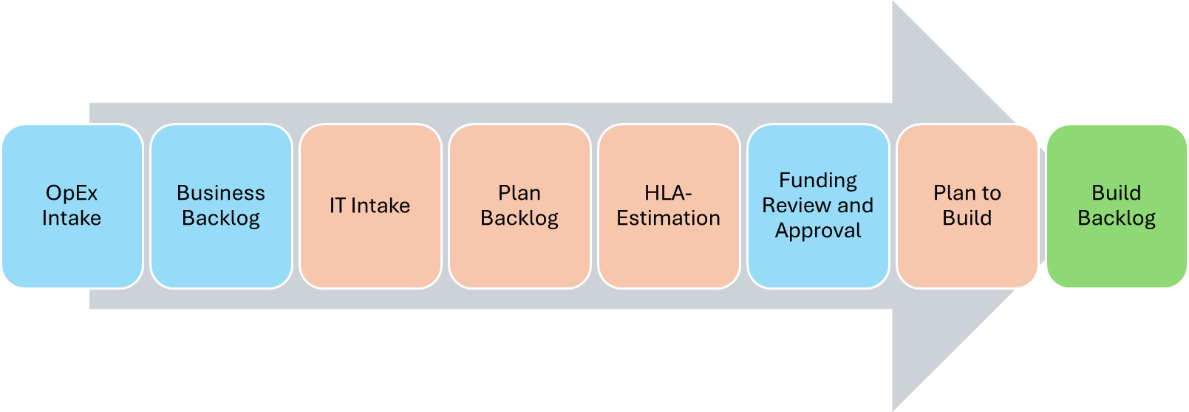
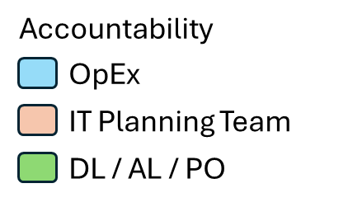
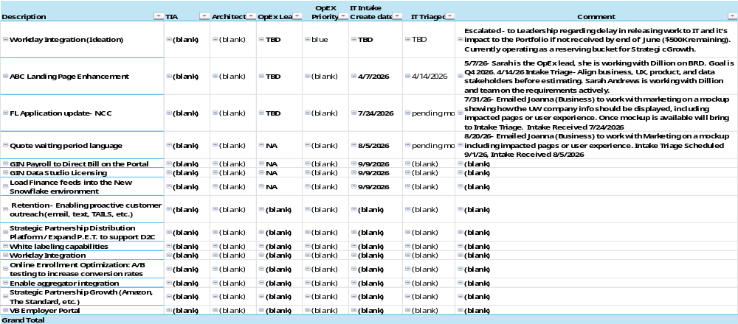
Business Backlog
Of the 7 items currently in Business Backlog, 3 have been received through IT Intake but returned to OpEx pending further business input. And 3 are new pending triage. The remainder are placeholders for 2027 identified focus areas pending business requirements and a new intake.

Slide 42
Plan Backlog

Slide 43
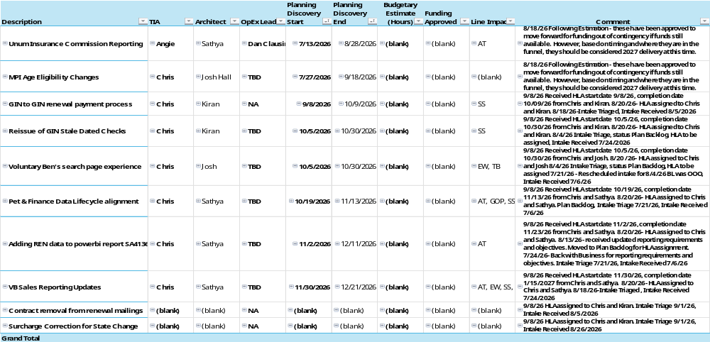
HLA Backlog
10 items currently in assessment / estimation process.
Notes:
Discovery Effort:
DL – 40 hrs
TA - 40
TL -40
Arch - 40
QE - 40
TIA – 40 (NB)
Total = 200 hours

Slide 44
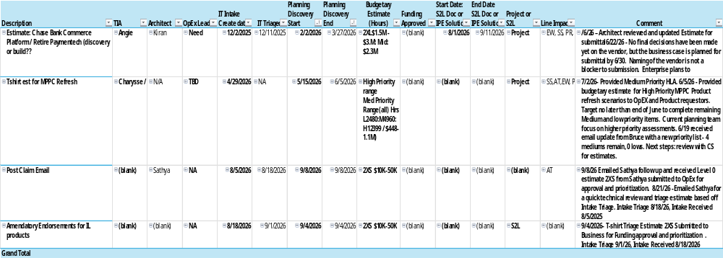
Pending Funding Backlog -
4 total items pending funding and prioritization. One requires follow-up with external team to understand 2027 external funding impacts.

Slide 45
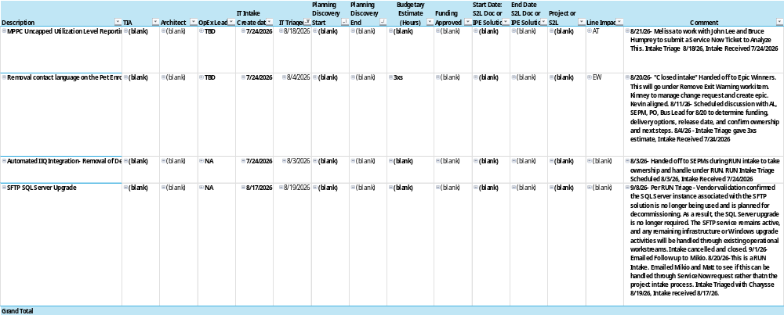
Closed / On Hold in Last Month
Items that were denied funding, de-prioritized, or closed for other reasons in the last month

Slide 46
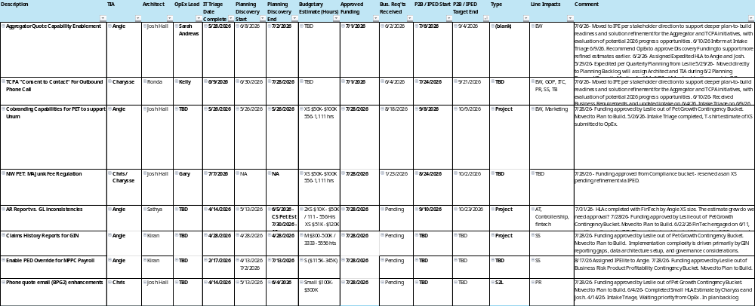
Plan to Build Start
Currently 8 items in Plan to Build, 4 are in progress and 4 are pending businessrequirements

Slide 47
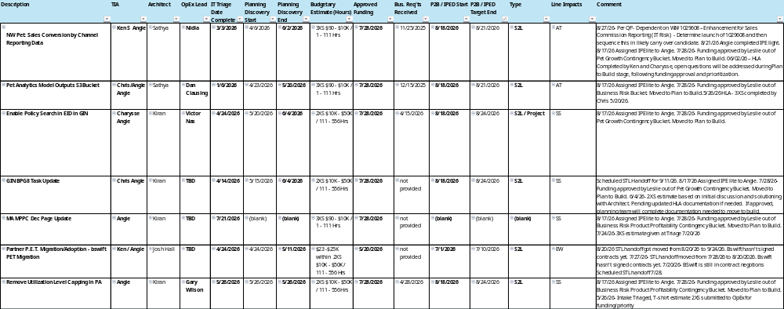
Plan to Build /Ready for Hand-off
Currently 7 items pending straight to the line hand-off. Two on the list will move to Carryover at the end of September

Slide 48
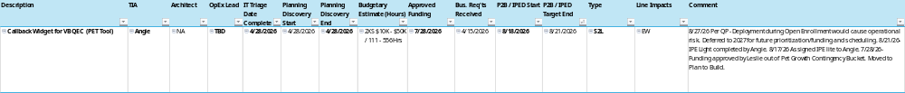
Carryover
Currently 1 items listed as carryover into the 1st qtr due to a decision not to take this work on in 4th quarter due to Open Enrollment impacts. I expect two more to join this list by the end of September.

Slide 49
Appendix

Slide 50
2026 Release Status – Work in Process

Slide 51
2026 Release Calendar Status
Target Release Date | Project Name | Delivery Leader | Op Ex Business Lead | Status | Note (reason for release date push)
9/16/2026 | Add a Pet | Rekha K | Nidia Gudino | Implemented
9/16/2026 | Firstvet Consultation File – IR change request | Rekha K | Kelly Heitman | Implemented
9/16/2026 | MVP3 UW Question Reduction (Find a Vet) | Kinney B | Sara Andrews | Implemented
9/16/2026 | Pet Model Law Reboot(Forms) | V Dinesh | Gary Wilson | On Schedule
9/16/2026 | Pricing Segmentation - (R9) NV, AK, ND | Kinney B | Alex Suarez | Implemented
9/23/2026 | MVP3 UW Question Reduction (Find a Vet) - Warranty | Kinney B | Sara Andrews | On Schedule | Minor release
9/23/2026 | Firstvet 1 Production defect | Rekha K | Kelly Heitman | On Schedule | Minor release
10/7/2026 | UW Optimization MVP2 (Dark Launch) | Lalitha K |  | On Schedule
10/14/2026 | Pricing Segmentation - (R10) RI, DC, CT | Kinney B | Alex Suarez | On Schedule
10/14/2026 | Scalability for 1-2 M policies | Dinesh |  | On Schedule
10/14/2026 | Firstvet consultation file error message fix | Rekha K | Kelly Heitman | On schedule
10/21/2026 | Employer Portal (Dark Launch) | Ali

Slide 52
2026 Release Calendar Status
Target Release Date | Project Name | Delivery Leader | Op Ex Business Lead | Status | Note (reason for release date push)
11/11/2026 | Pricing Segmentation - (R11) | Kinney B | Alex Suarez | On Schedule
11/11/2026 | UW Optimization MVP2 | Lalitha K | Sarah Andrews | On Hold | EW will dark launch on 9/30 / SS is on hold until further assessment
11/11/2026 | Tailwind Phase 1 (Go-Live) | Shilpa | Dan Clausing | TBD
11/11/2026 | Employer Portal (Go-Live) | Ali D |  | TBD
11/11/2026 | GIN 2026 Update | Chalam | NA (risk project) | TBD
11/11/2026 | MMPC - Multiple Denial Code Handling Enhancement | Kinney B | Alex Suarez | On Schedule
11/11/2026 | PEC Product & UW Enhancements | Kinney B | Gary Wilson | On Schedule
12/9/2026 | MPPC to MPI | Lalitha K | Gary Wilson | Dark Launch | Pending Steering committee approval
12/09/2026 | Sales Commission Reporting | Chalam | Ellis Ryan | TBD | Originally for 11/11
12/09/2026 | UW Optimization MVP2 (Dark Launch) | Lalitha K | Sarah Andrews | On Hold | Originally slotted for 11/11
On Hold | Informatica to Python | Chalam | NA (risk project) | On Hold
12/9/2026 | Employer Portal (Post Prod-Support) | Ali D |  | TBD
10/14/2026 | UW Optimization MVP1 | Lalitha K | Sarah Andrews | On Hold | Due to business risk assessment and loss ratio concerns

Slide 53
Nationwide Financial Portfolio Project Detail: Pet (9/9) | Personal Lines $2M+ Project Detail |  | SLT Sponsor: Joel Carnes / Misty Kuamoo |  |  | Execution Owner: Andromeda Thompson / Braden Love
Y | Pet Portfolio (Pet Platform Transformation) incl. Payroll Experience & Partner Portal | Capabilities: Modernizing policy administration, billing and claims system | Scope: G | Schedule: Y | Budget: G |  | Actual / Forecast: G | Biz Case On-Track: Yes
Business Case Outcome: Platform Modernization - Pricing sophistication, integration capabilities, & technology risk mitigation | Business Case Outcome: |  | X |  |  |  | X
Prior Key Milestones Delivered: <30-60-90> |  | Next Key Milestones Planned: <30-60-90>
Program status: Yellow. Program remains on an executable path; however, Employer Portal schedule contingency has been fully consumed, requiring active risk mitigation to maintain target delivery dates. Employer Portal: Bundle 4 completed, and the first production dark launch was successfully executed. Bundle 5 and 6 schedule at risk due to scope change. Payroll Billing Defects: Trending Green. Wave 2 was deployed to production on 8/19, one day ahead of plan. Wave 1 was previously deployed. Policy Migration: PA and MD releases deployed; validation is underway Manual Migration discovery has begun. The SOW is currently in development Major Medical: Development is in progress. Resource capacity constraints may impact the schedule NY/Unapproved State Product Build: SOW development underway with Cognizant MM-to-MM : SOW development underway with ITS Conversions progress (as of 8/19) excludes Major Medical, legacy products and DOI-unapproved states : | Key Business Outcome Metric (KPI): | Employer Portal – Key Milestones • Bundle 5 Testing: 9/29; Bundle 6 Testing: 10/2 • IAM Dark Launch: 10/8 • Portal Dark Launch: 10/21 • Finance Dark Launch: 10/23 • Production Go-Live: 11/11 • Warranty Release: 12/9 Payroll Billing Defects: Wave 3 deployment scheduled for 9/17 Wave 4 analysis underway Policy Migration: Manual Migration SOW approved; Discovery phase completed. MM-to-MM Migration: SOW approved; discover completed. Major Medical Product Build: Resource gap addressed; development is progressing as planned. New York Product Build : SOW finalized. Core team staffed; discovery phase is beginning. Key Risks: Employer Portal Schedule: Risk: The approved rebaseline has no remaining schedule contingency. Bundle 6 testing, scope decisions, and defect remediation activities could impact October dark launch milestones and the 11/11 go-live. Mitigation: Daily defect and backlog triage is in place; non-MVP scope has been deferred to future releases to protect critical milestones. 2027 Funding: Risk: Preliminary forecasts indicate an additional funding requirement of approximately $2M for 2027. Mitigation: Pet Portfolio and Finance teams are evaluating funding options and accelerating eligible work into 2026 to reduce 2027 demand.
Benefits: | Key Business Outcome Metric (KPI): | Key Performance Indicators:
Platform Modernization: Pricing sophistication Integration capabilities Technology risk mitigation |  | Faster product launches and channel growth More agile product administration and lifecycle management Quicker time to market for new products and changes Better customer and partner experience through self-service Lower cost and risk through modernization and legacy retirement
Product | States Deployed | Policies Migrated | Original Premium Migrated | % Complete
MM to MPI | CA | 66,550 | $58.6M​ | 99.7%​
MPP to MPPC | 49 | 531,739 | $424.3M​ | 86.5%​
WP to MPI | 25 | 37,946 | $81.1M​ | 79.9%​
Total |  | 635,984 | $564 M​ | 86.6%​

